Slide 1
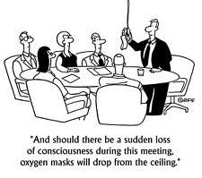
Committees
Why are they important?

Slide 2
Committees
AA Service Committees-Why are they important?
A.A. service committees work to ensure the A.A. message reaches people who may need it. Many alcoholics first hear A.A.'s message of hope through these committees. In addition…..
Committee Definition:
A group of people appointed for a specific function, typically consisting of members of a larger group. A person entrusted with the charge of another person or another person's property.
Committee Definition: (legal terms)
One or more members of a legislative body to whom is specially referred some matter before that body, in order that they may investigate and examine into it and report to those who delegated this authority to them
Definitions and committee Information was taken from the Bowling Proprietor’s Assn. Amer. website and has been edited

Slide 3
Committees
4 Types of Committees:
Standing Committees: Standing committees deal with issues of permanent area concern.
Conference committees: For a bill to become law both houses must approve identical versions. (Trustees/Conference)
Select committees: Deals with temporary issues, investigation. (Ad Hoc)
Joint committees: a committee whose members are from two or more different organizations (PI/CPC)

Slide 4
Committees
Committee Members
Should be in that committee because they are knowledgeable about or interested in the committee's area of activity.
Should know what the specific responsibilities of the committee are.
Should know what the area's practices, policies, and procedures are.
Should know what the past performance of the committee has been.
Should get involved and participate.

Slide 5
Committees
Committee members are asked to:
Review the meeting agenda carefully before coming to the committee meeting and read the supporting material.
Stick to the agenda during the meeting. Bring up new business only at the appropriate time.
Keep replies short and to the point. Seek information, do not deliver a long speech.
If what you have to say is a genuine contribution and really does make a difference, don't let it get lost in confused conversation.

Slide 6
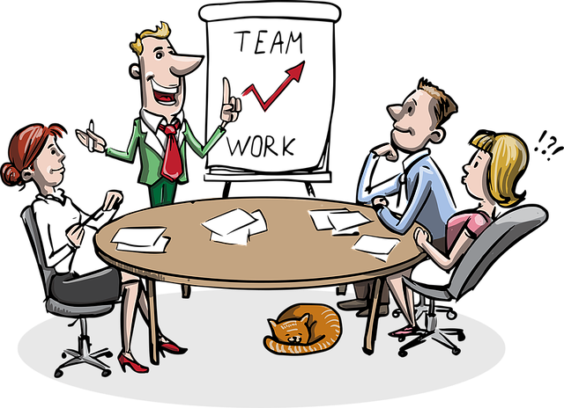
Committees
Audience participation:
Give me 3 reasons why committees are important.
Give me an example of an area or district committee.
What committee would you join at the district or area level?
How do you join a committee at the district or area level?
How much sobriety do you need to join a committee?

